Slide 1
MY POP, MY HERO
By Jodie Bickel

Slide 2
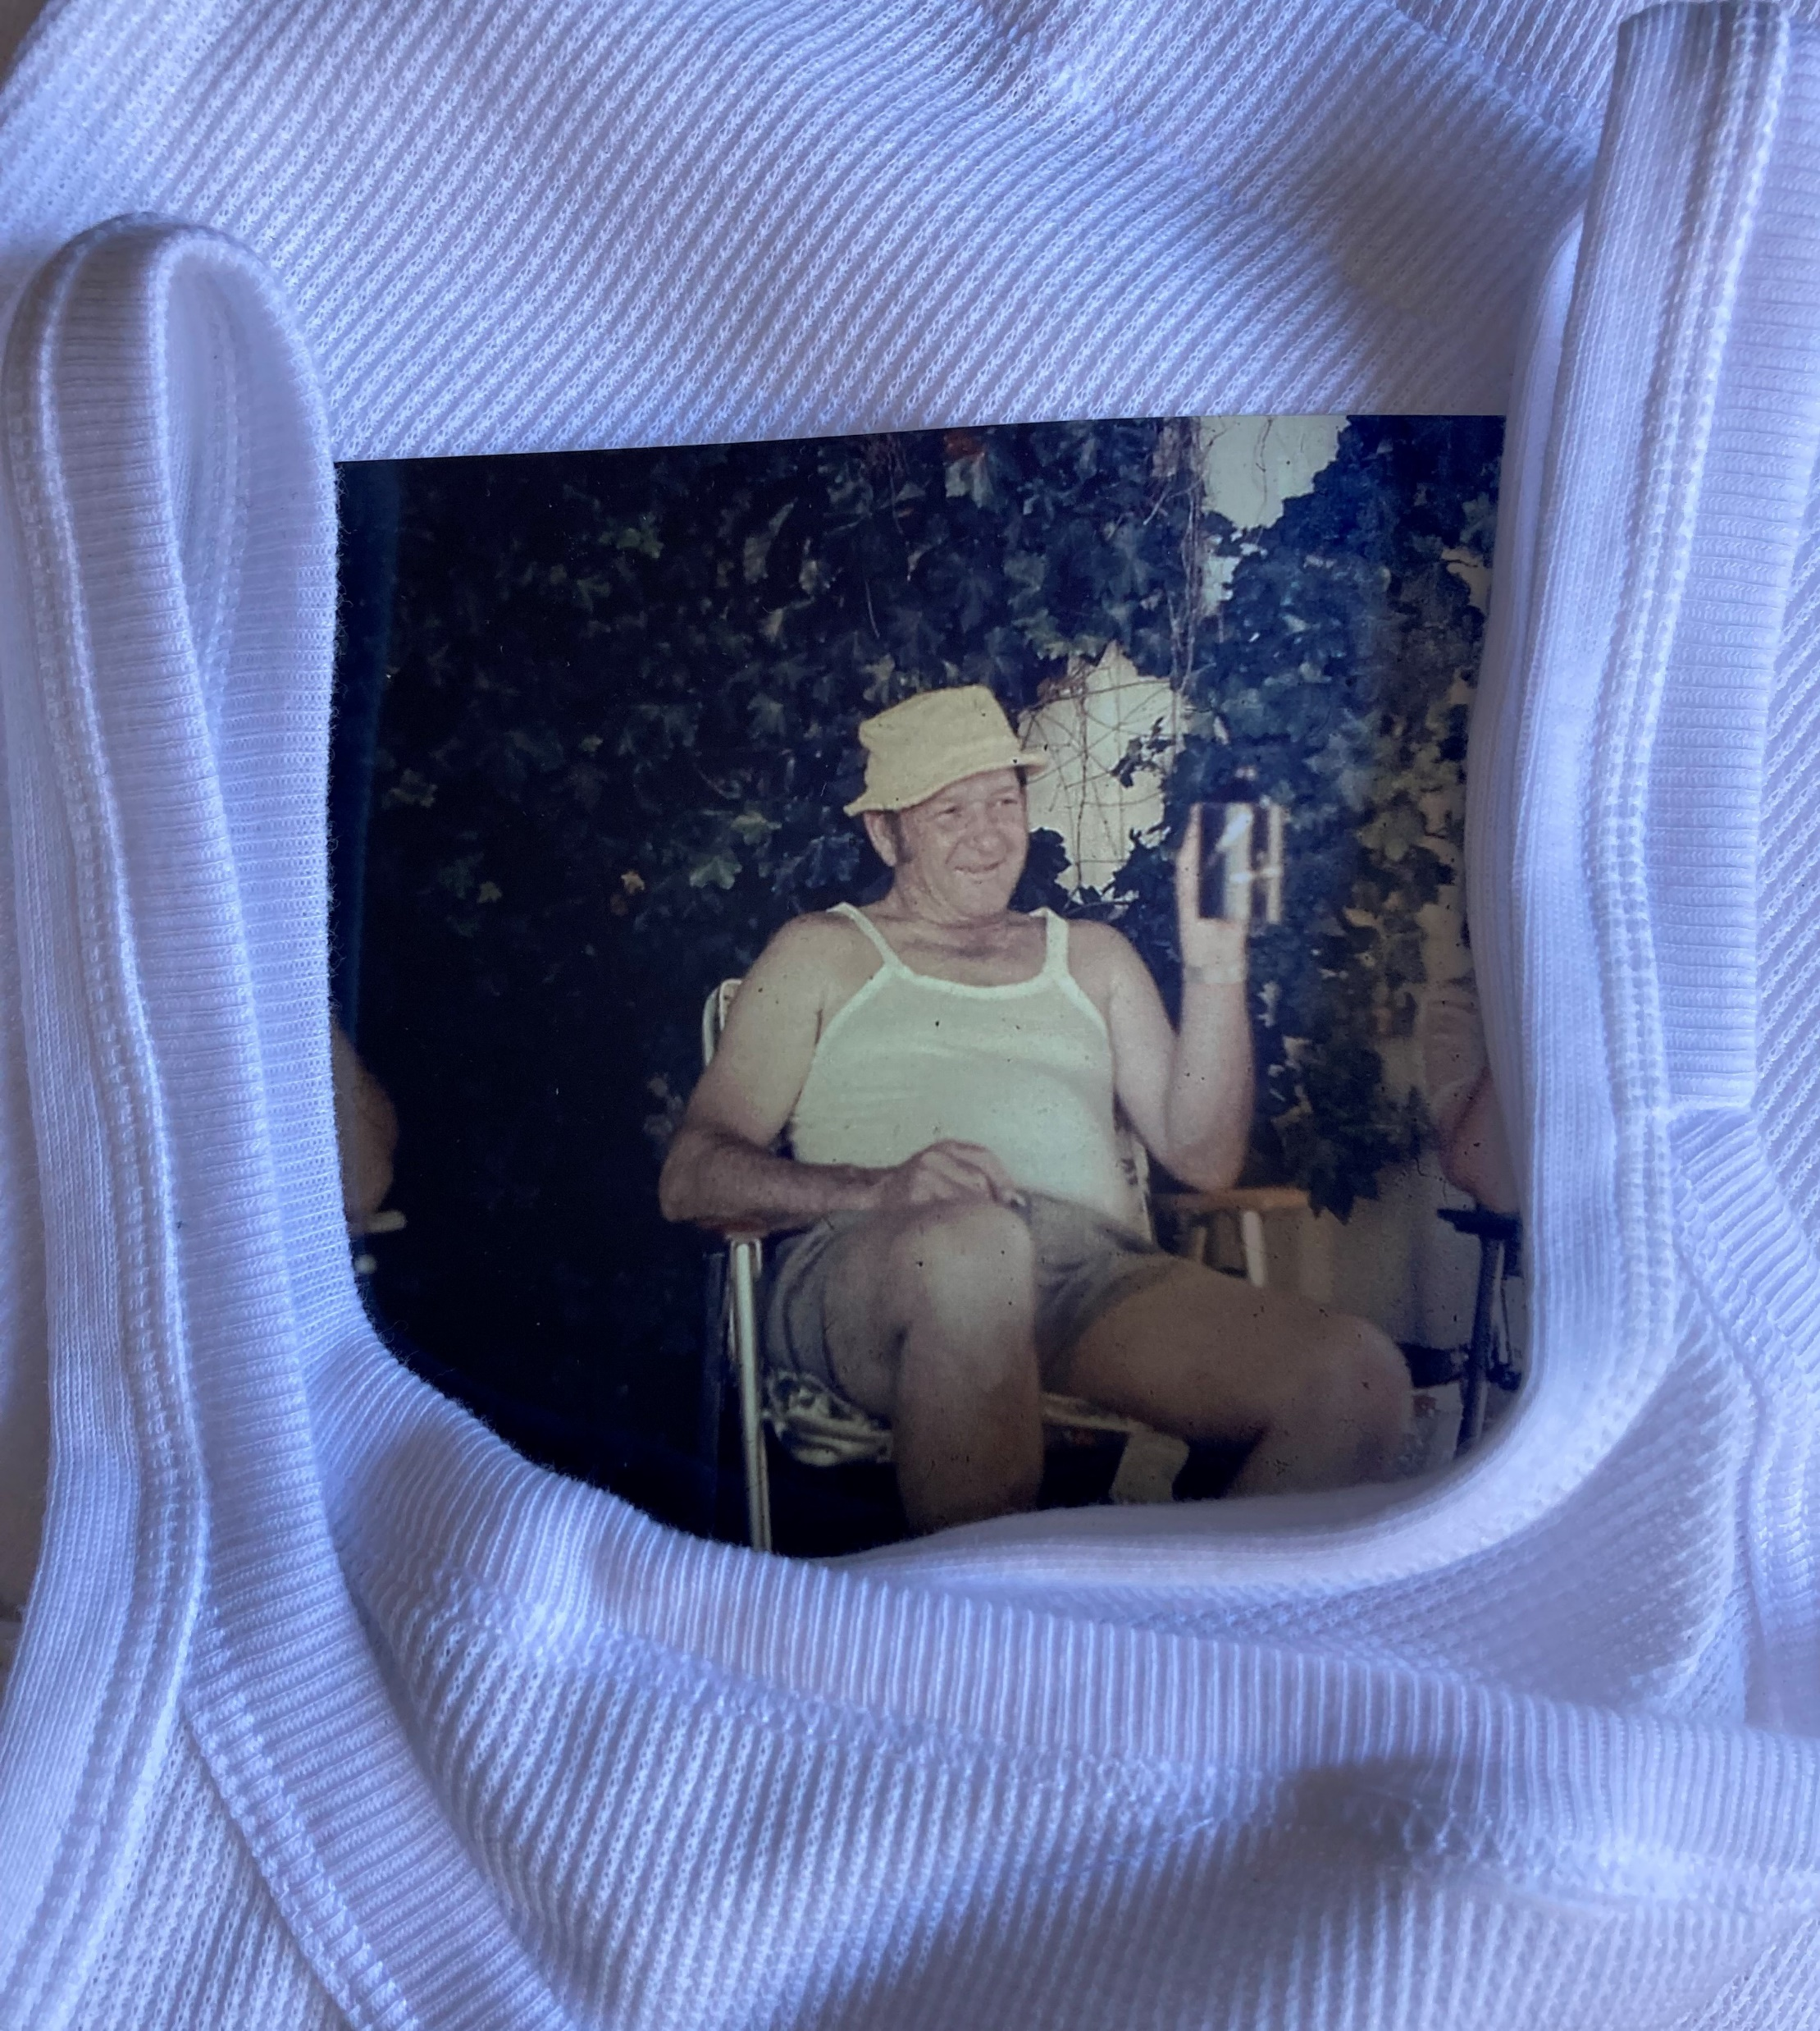
MY POP
MY HERO
Here is my pop, my hero, enjoying a rare moment of relaxation, decked out in his favourite ensemble;
a bucket hat, a chesty bonds singlet and shorts. His fondness for the singlet began in WW2 when two were issued as part of his supply kit.
Let’s find out more about the man under the waffle weave singlet.

Slide 3
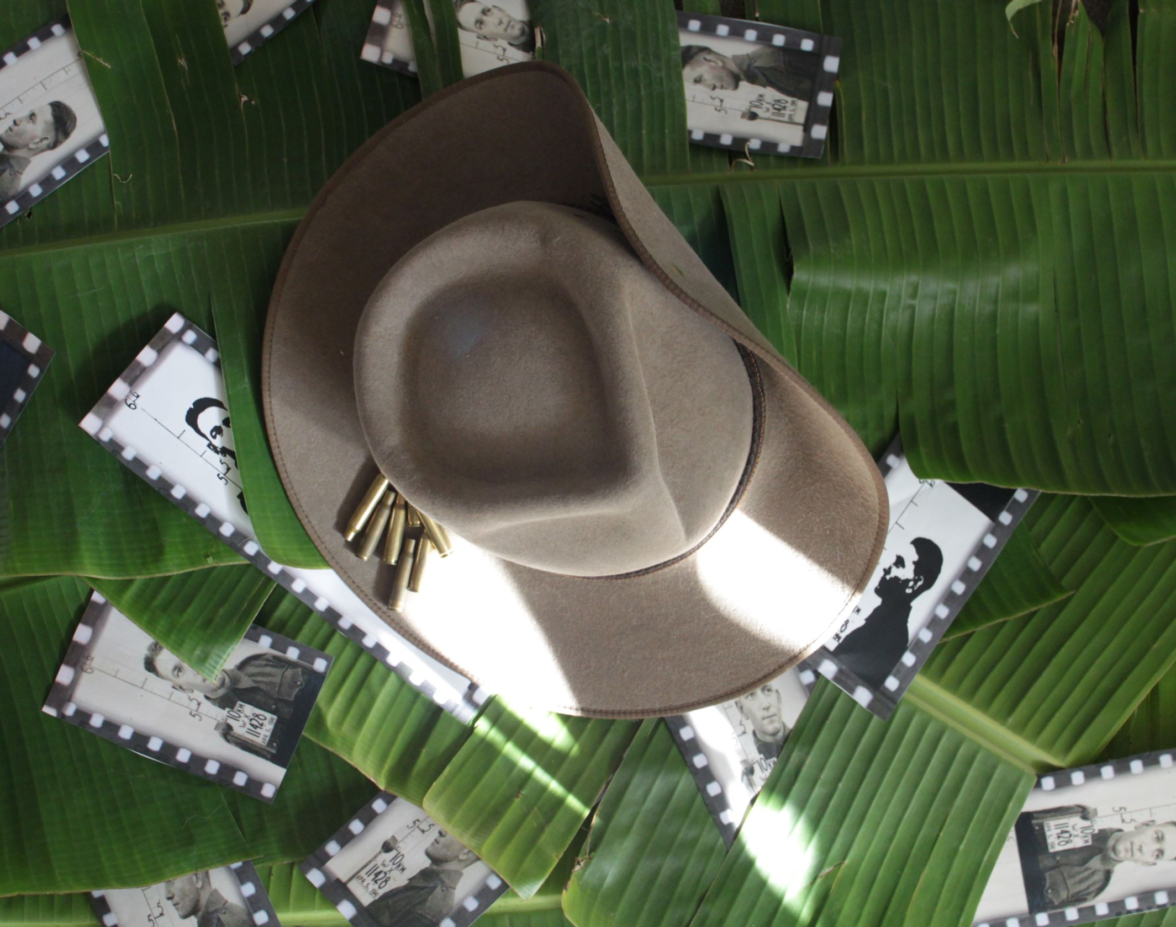
It’s enlistment time in 1941, and a fresh faced Raymond Alfred Gould stands steady as the photographer shoots twice.
The next time he’s shot at, is in the unforgiving Papua New Guinean jungles, where the only reminder of home is the rising and setting sun.

Slide 4
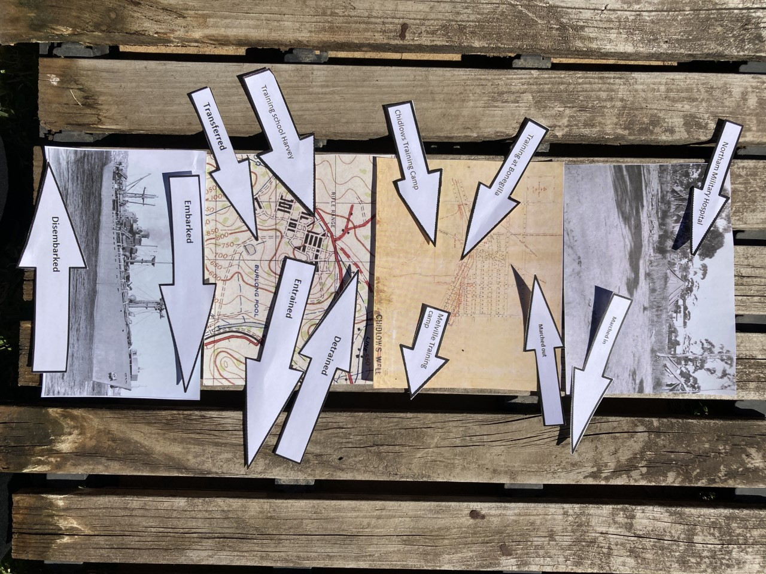
He embarks on a gruelling and chaotic training regime.
He’s marched in, marched out, transferred, entrained, detrained, granted leave and admitted to two military hospitals.
Cracks were starting to form.

Slide 5
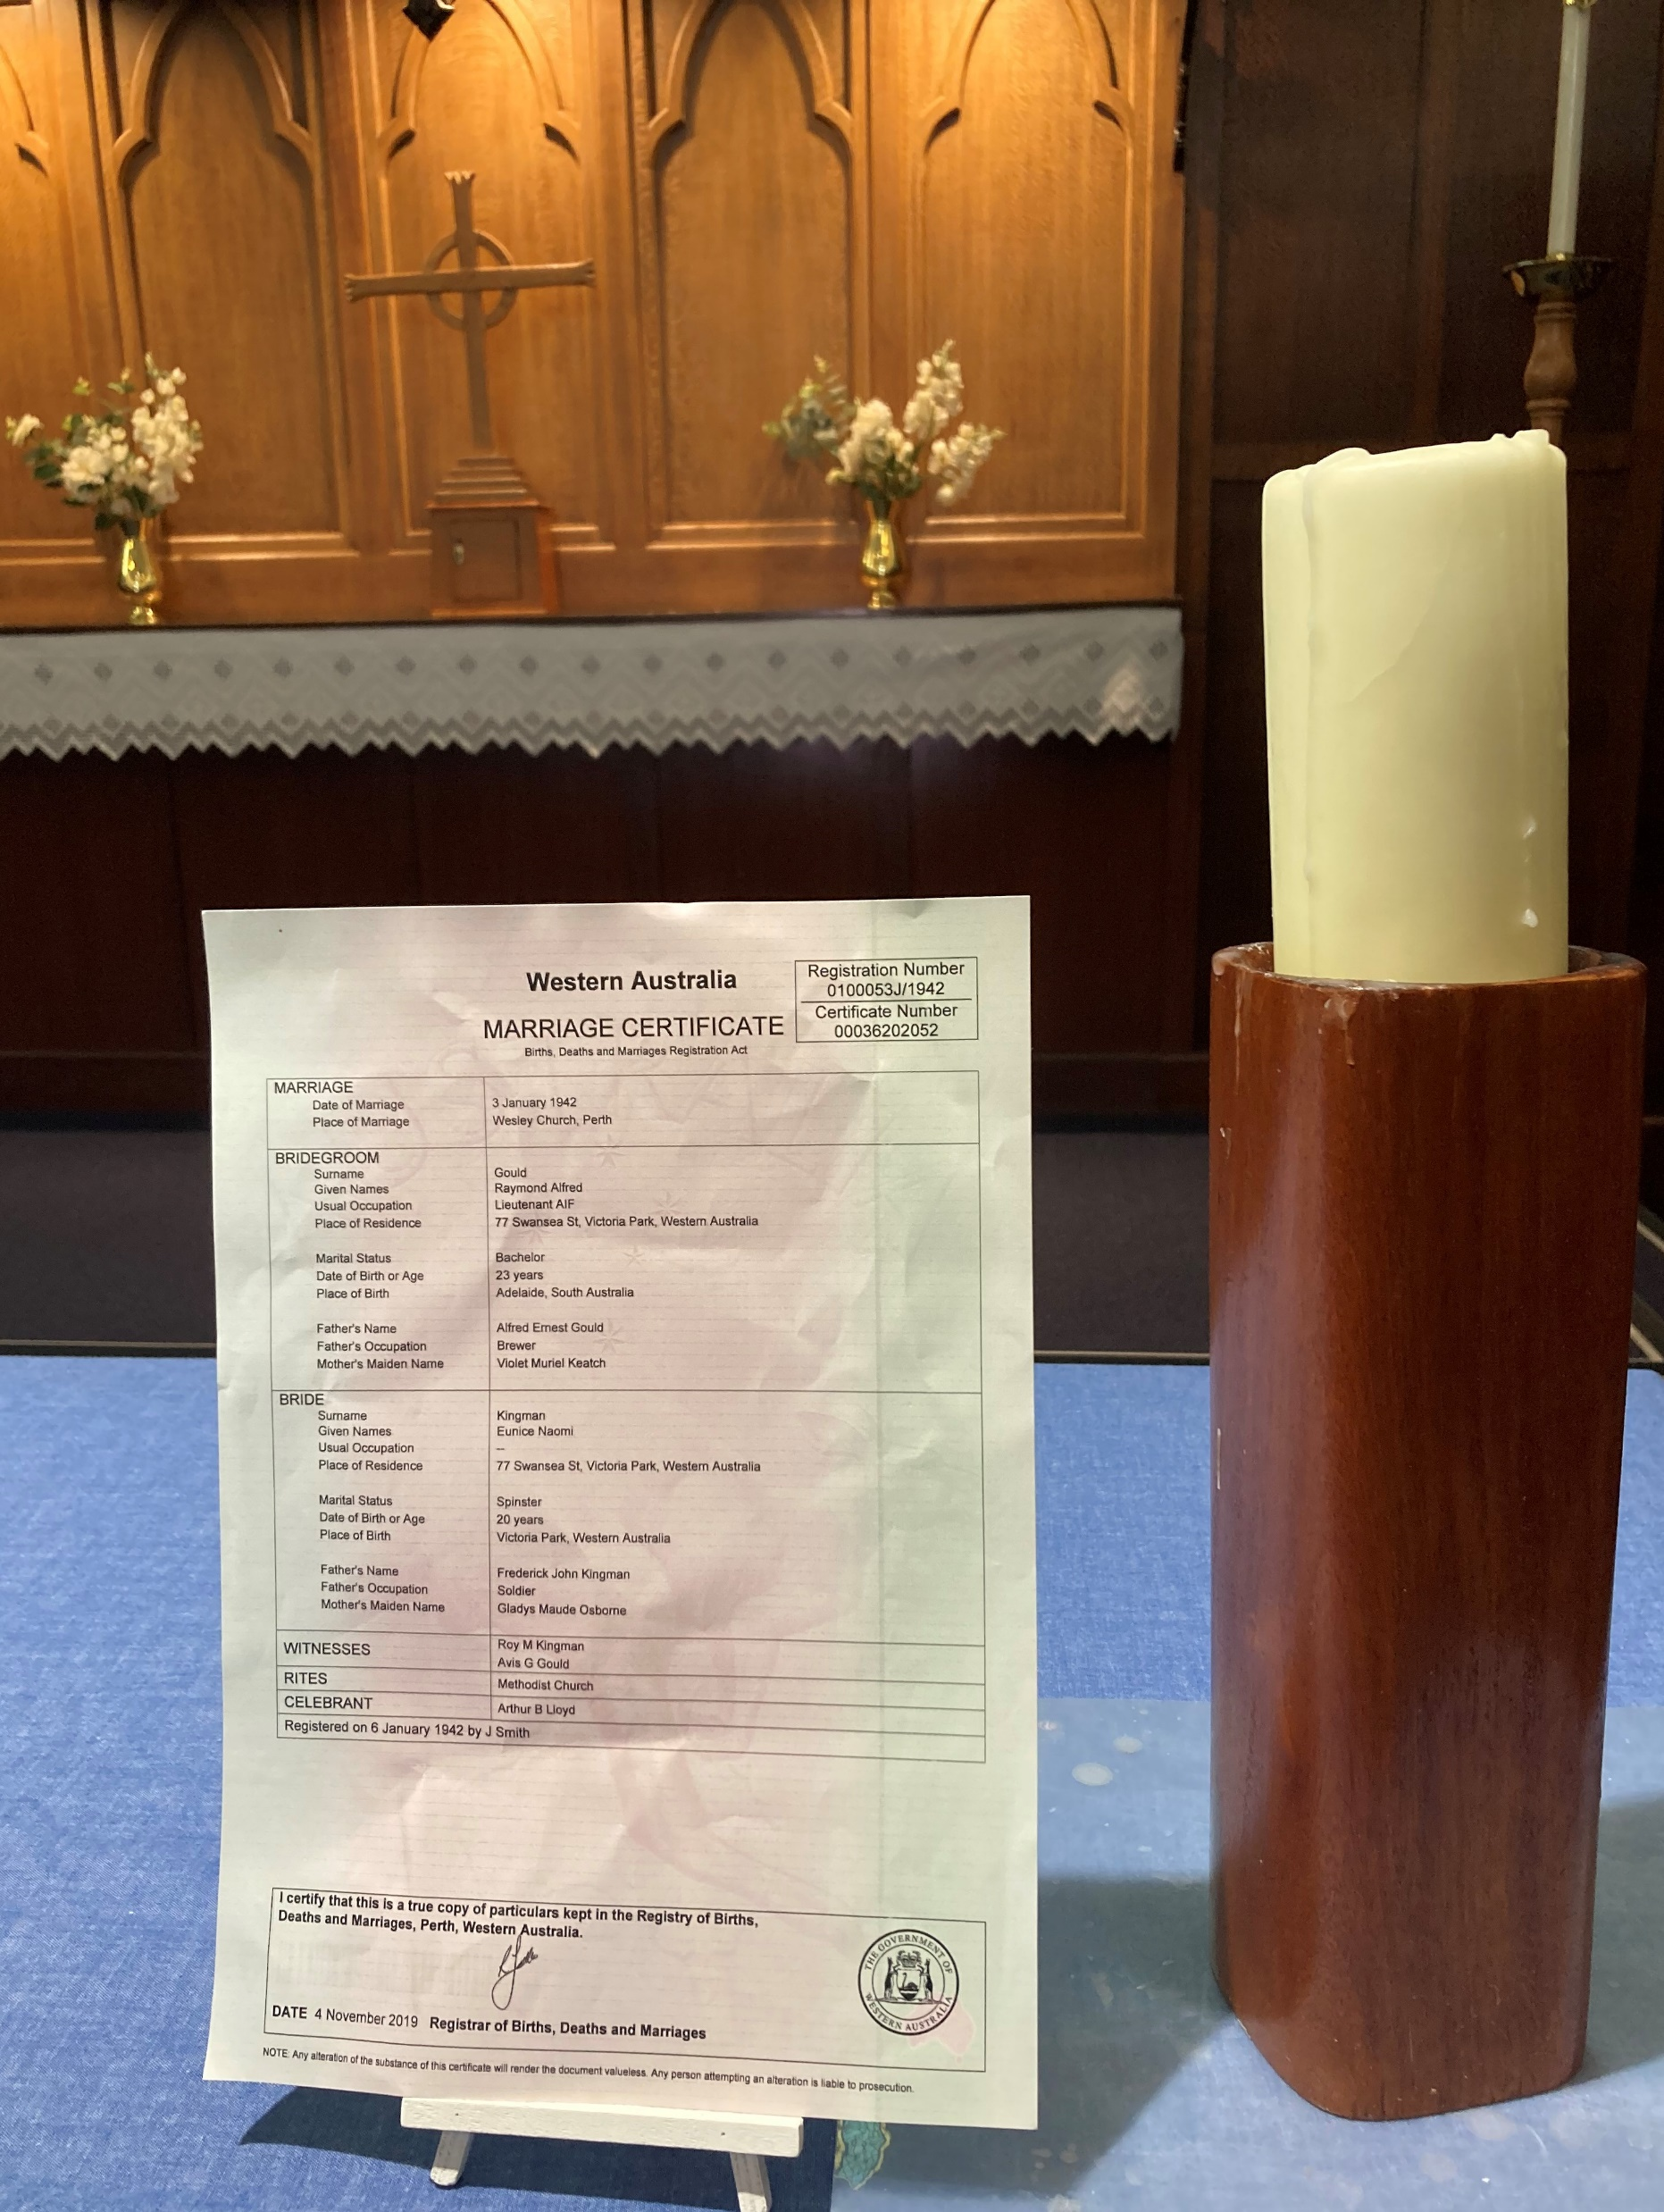
In the midst of his training he is granted leave to marry the love of his life.
“I, Raymond Alfred Gould, take thee, Eunice Naomi Kingman, to be my wedded wife, to have and to hold from this day forward, for better, for worse…”
His beautiful wife will wait three more years for him to return home.

Slide 6
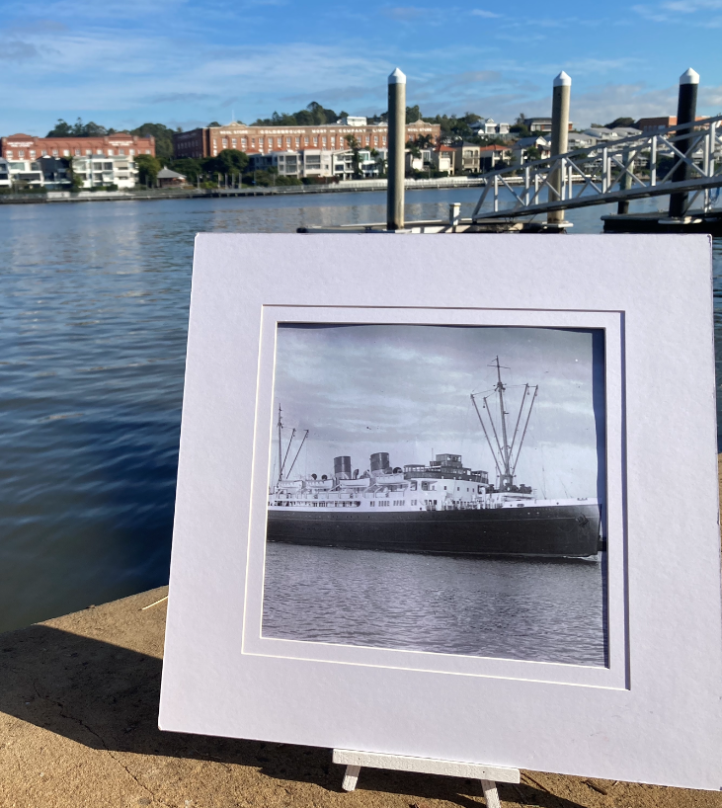
The boy from the bush set sail numerous times across the Torres Strait between Brisbane and Jacquinot Bay, PNG.
He boarded ships including : SS Taroona, SS Duntroon, SS Ormiston and the SS Seymour. These repurposed passenger vessels were requisitioned for service as troopships from 1939-1945.

Slide 7
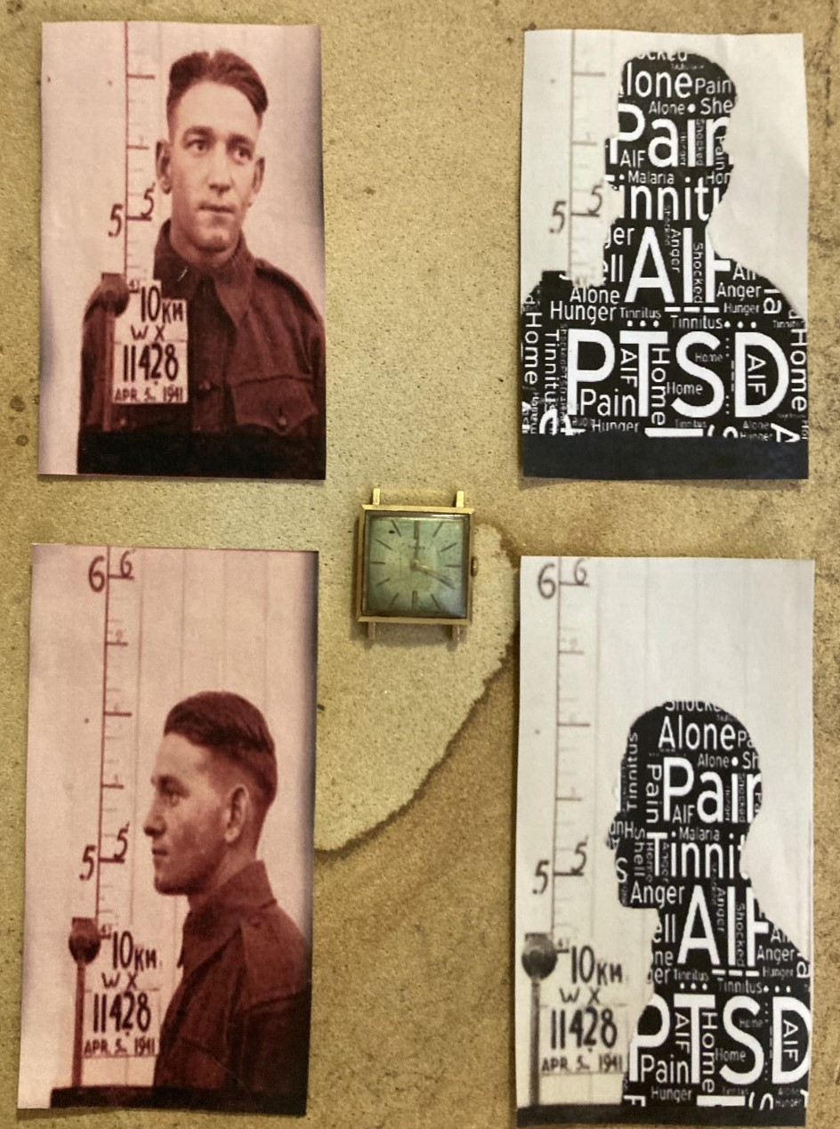
War time was to be the hardest challenge of his life. Confronted with death, hunger, harsh living conditions, and homesickness - over time it took its toll.
His new fight would be in the form of a mental health battle.

Slide 8
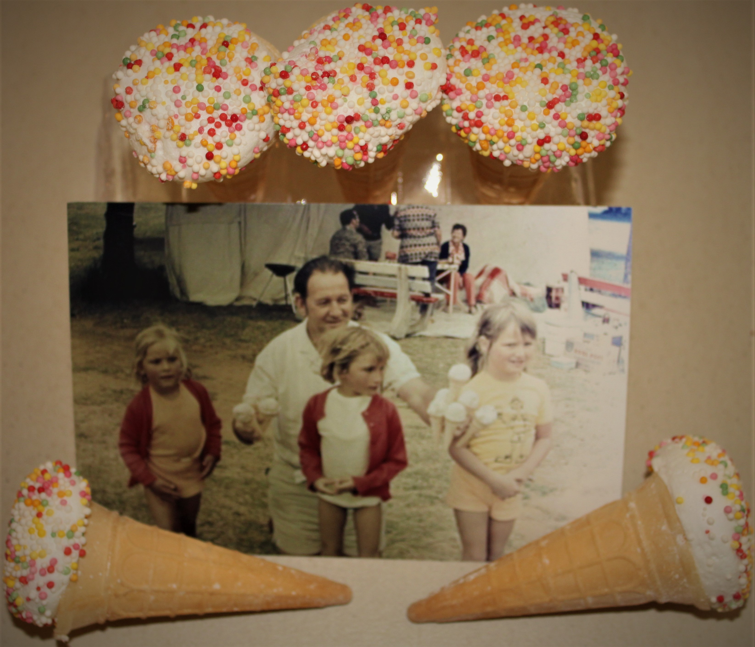
Following repatriation he continually struggled with mental health scars, and sought joy by spending time with his grand children. In this moment, juggling eight ice-creams was the full extent of his worries.
MY POP, MY HERO.

